Slide 1
LECTURE FOUR – CYBERSECURITY
LAW2291_2024
Contemporary Issues in Biolaw (24/25)

Slide 2
0.0
Last lecture
Keep AI in or as Medical Devices in mind.
Contents:
Overview of cybersecurity terms and concepts
Perspectives from AIA, MDR on security
Cyber Resilience Act
Network Information Security Directive (NIS2 Directive)
Final comments

Slide 3
1.0 Security Concepts
Everything is interconnected
Security: Freedom from adversarial failures
Digital devices everywhere = cybersecurity everywhere
Security = Cybersecurity
Safety?

Slide 4
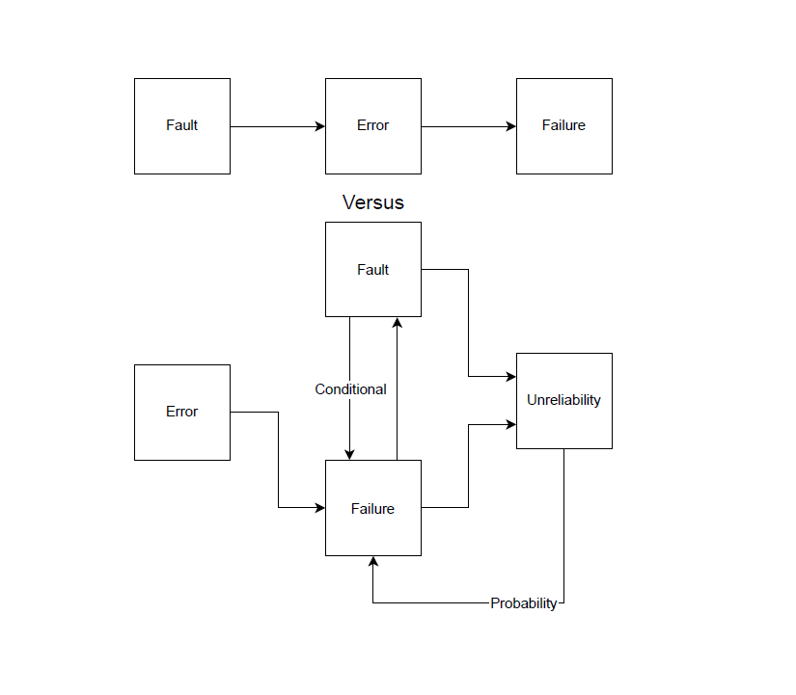

Slide 5
1.1
Unlike safety, security is simpler:
First state <-> second state
What matters is that it is caused by an adversary.
And the modelling from safety can only be used to describe the system – errors do not exist with adversaries, while hazards work.
Additionally, adversarial failures are used instead
Unreliability = insecure

Slide 6
1.2
Other relevant concepts:
Attack surface
Threat modelling/models
Testing
Defences
Supply Chain Security
Physical Cybersecurity
Main points are that one understands the device, its environment, its users, its usage of public infrastructure, its adversaries, and so on.

Slide 7
2.0 Cybersecurity in the AIA and the MDR
Functionality – it is a product/equivalent.
Its purpose requires protection and functionality – soft but direct
While Article 15 is for high-risk AI, it is worth looking at generally anyway. Who knows – maybe indirect usage later?

Slide 8
1. High-risk AI systems shall be designed and developed in such a way that they achieve an appropriate level of accuracy, robustness, and cybersecurity, and that they perform consistently in those respects throughout their lifecycle.
2. To address the technical aspects of how to measure the appropriate levels of accuracy and robustness set out in paragraph 1 and any other relevant performance metrics, the Commission shall, in cooperation with relevant stakeholders and organisations such as metrology and benchmarking authorities, encourage, as appropriate, the development of benchmarks and measurement methodologies.
3. The levels of accuracy and the relevant accuracy metrics of high-risk AI systems shall be declared in the accompanying instructions of use.
4. High-risk AI systems shall be as resilient as possible regarding errors, faults or inconsistencies that may occur within the system or the environment in which the system operates, in particular due to their interaction with natural persons or other systems. Technical and organisational measures shall be taken in this regard.
The robustness of high-risk AI systems may be achieved through technical redundancy solutions, which may include backup or fail-safe plans.
High-risk AI systems that continue to learn after being placed on the market or put into service shall be developed in such a way as to eliminate or reduce as far as possible the risk of possibly biased outputs influencing input for future operations (feedback loops), and as to ensure that any such feedback loops are duly addressed with appropriate mitigation measures.

Slide 9
5. High-risk AI systems shall be resilient against attempts by unauthorised third parties to alter their use, outputs or performance by exploiting system vulnerabilities.
The technical solutions aiming to ensure the cybersecurity of high-risk AI systems shall be appropriate to the relevant circumstances and the risks.
The technical solutions to address AI specific vulnerabilities shall include, where appropriate, measures to prevent, detect, respond to, resolve and control for attacks trying to manipulate the training data set (data poisoning), or pre-trained components used in training (model poisoning), inputs designed to cause the AI model to make a mistake (adversarial examples or model evasion), confidentiality attacks or model flaws.

Slide 10
2.1
Authorities, notified bodies must consider security, as will providers of general AI
Not as positive as it could be – low risk AI can be a gateway into other systems.
Better than initial proposal at least.

Slide 11
2.2 MDR
Annex I
Functionality
Intended usage requires security?
The teleological purpose of the MDR is violated without adequate security.

Slide 12
3.0 Cyber Resilience Act
Full text is out!
Relevance: Non-medical devices, cumulatively on things that are part of NIS2 coverage, everything almost (wide coverage)
Product focus
For us – gives basic cybersecurity requirements for AI which are not covered by the MDR

Slide 13
Art 1 (CRA)
This Regulation lays down:
(a) rules for the making available on the market of products with digital elements to ensure the cybersecurity of such products;
(b) essential requirements for the design, development and production of products with digital elements, and obligations for economic operators in relation to those products with respect to cybersecurity;
(c) essential requirements for the vulnerability handling processes put in place by manufacturers to ensure the cybersecurity of products with digital elements during the time the product is expected to be in use, and obligations for economic operators in relation to those processes;
(d) rules on market surveillance, including monitoring, and enforcement of the rules and requirements referred to in this Article.

Slide 14
3.1
Article 13(2):
2. For the purpose of complying with the obligation laid down in paragraph 1, manufacturers shall undertake an assessment of the cybersecurity risks associated with a product with digital elements and take the outcome of that assessment into account during the planning, design, development, production, delivery and maintenance phases of the product with digital elements with a view to minimising cybersecurity risks, preventing incidents and minimising the impacts of such incidents, including in relation to the health and safety of users.

Slide 15
3.2
Similar structure to what we have seen before
Notified bodies, authorities etc.
Strong focus on testing and providing results
Depends on manufacturers/economic operators
Generally quite strong
Weak for a regulation however..

Slide 16
4.0 NIS2
Followup from NIS1
Critical infrastructure cybersecurity
Applies to AI used in hospitals – the latter is critical infrastructure always
Applies even if used in treatment outside of hospitals
Additional certification, but easier if already fulfilling other legislation

Slide 17
4.1
Article 1 is worth it, but more important here are the measures needed.
NIS2 is for states to implement, exceptions to private and public entities by themselves
Chapter IV
Article 21 (cybersecurity risk management measures)
Very strong – actual actions depends on jurisdiction
Prevention of hazards – security within etc.

Slide 18
4.2
Supervisory Structure – Chapter VII
Potentially very strong scheme
A development from NIS1
Yet to be tested
Like NIS1, extremely complex

Slide 19
4.3 Art 33(2)
2. Member States shall ensure that the competent authorities, when exercising their supervisory tasks in relation to important entities, have the power to subject those entities at least to:
(a) on-site inspections and off-site ex post supervision conducted by trained professionals;
(b) targeted security audits carried out by an independent body or a competent authority;
(c) security scans based on objective, non-discriminatory, fair and transparent risk assessment criteria, where necessary with the cooperation of the entity concerned;
(d) requests for information necessary to assess, ex post, the cybersecurity risk-management measures adopted by the entity concerned, including documented cybersecurity policies, as well as compliance with the obligation to submit information to the competent authorities pursuant to Article 27;
(e) requests to access data, documents and information necessary to carry out their supervisory tasks;
(f) requests for evidence of implementation of cybersecurity policies, such as the results of security audits carried out by a qualified auditor and the respective underlying evidence.

Slide 20
4.4 Article 39
Member States shall lay down rules on penalties applicable to infringements of national measures adopted pursuant to this Directive and shall take all measures necessary to ensure that they are implemented. The penalties provided for shall be effective, proportionate and dissuasive. Member States shall, by 17 January 2025, notify the Commission of those rules and of those measures and shall notify it, without delay of any subsequent amendment affecting them.

Slide 21
Final Part
Cybersecurity regulation is finally going somewhere
Direct and rational fulfilment of standards and the basic notion of preventing adversaries from tampering with AI is great
Extremely important due to the risks when such AI systems fail at large.
Other:
The timeslot on Friday means you can sleep in more
I am in my office, PCL119 and available there – but not after due to teaching/seminars

